Slide 1
Over story growth
NIC Growth Unique allometry (30m max height all) GLI quadrants

Slide 2
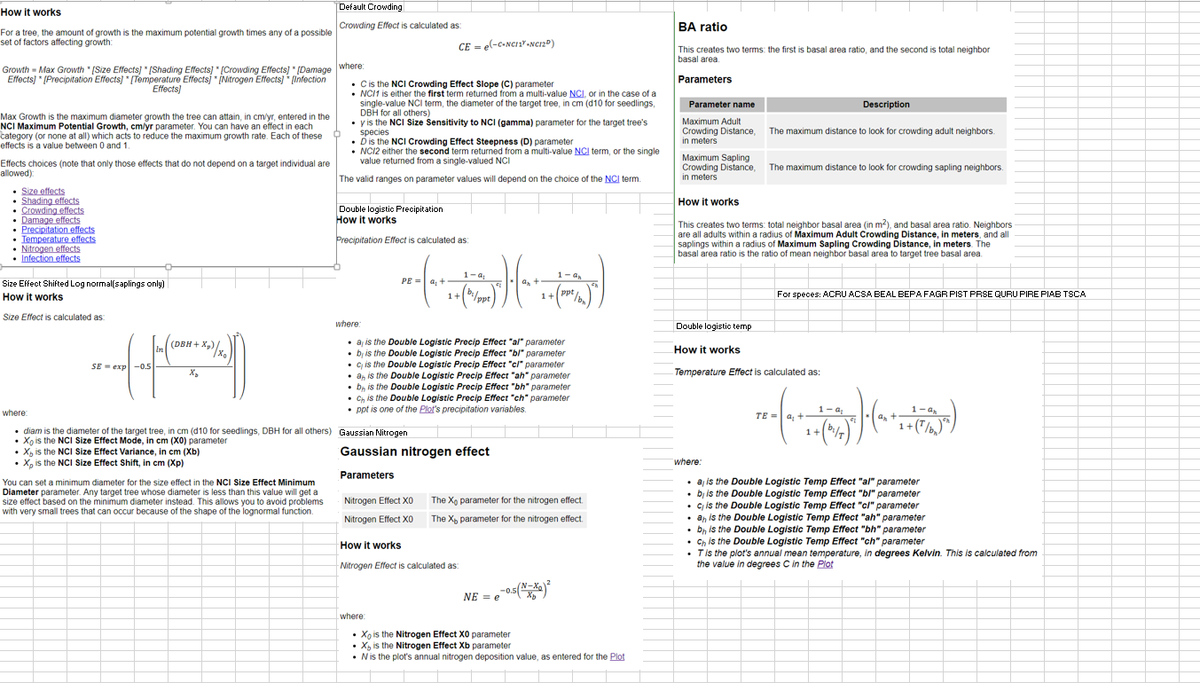
Sapling GCI growth

Slide 3
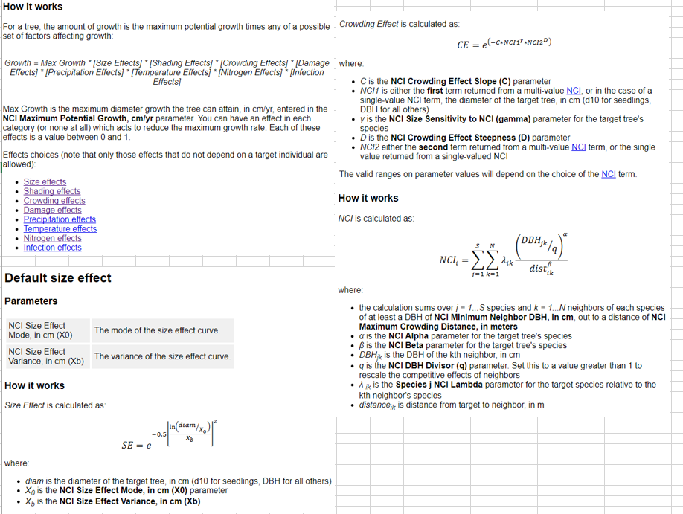
Adult NCI GROWTH

Slide 4
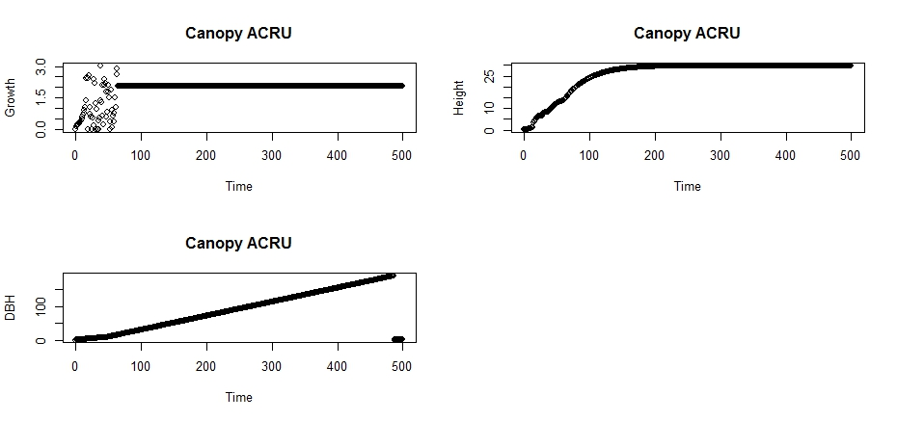
ACRU

Slide 5
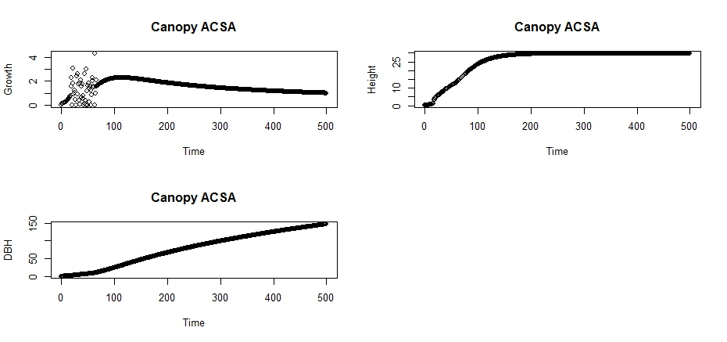
ACSA

Slide 6
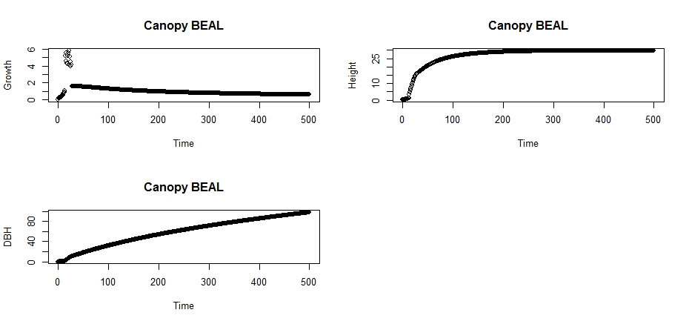
BEAL

Slide 7
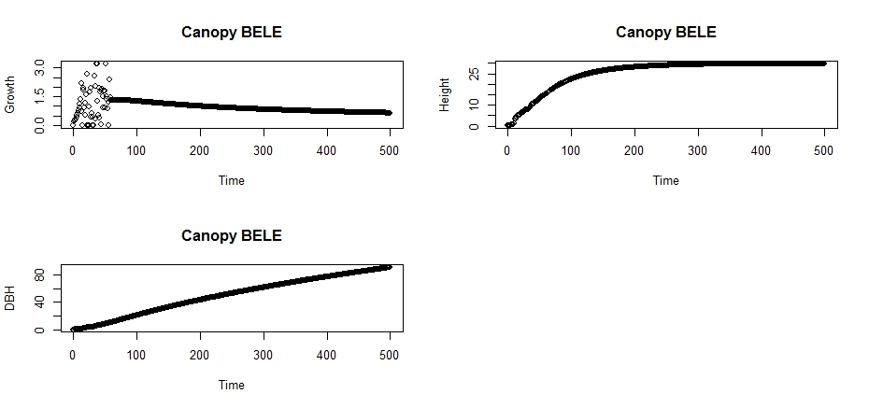
BELE

Slide 8
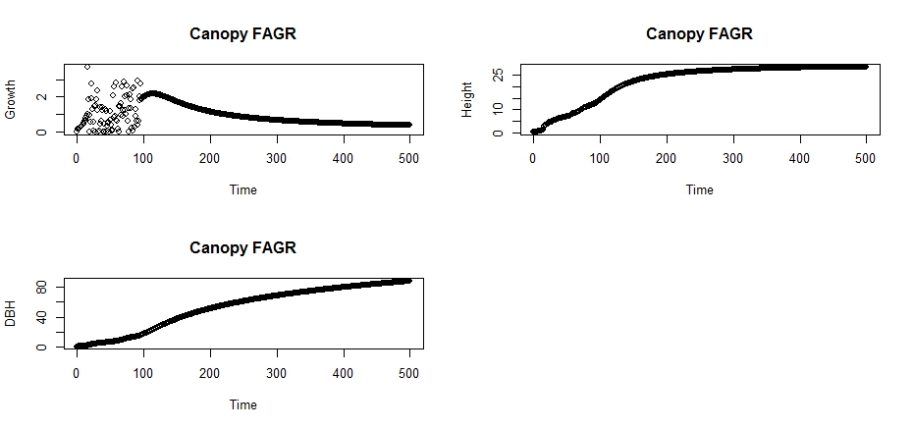
FAGR

Slide 9
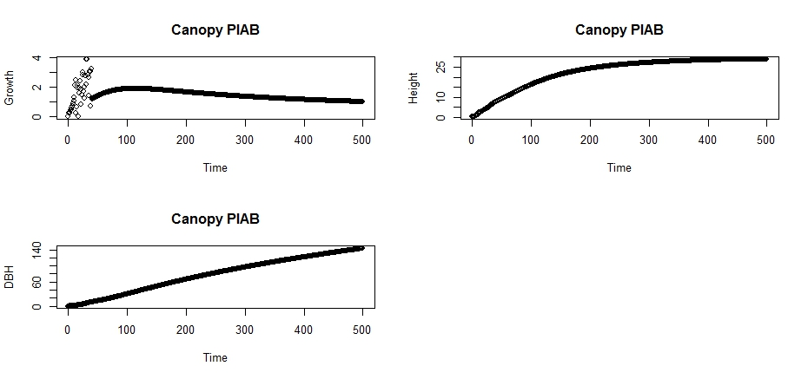
PIAB

Slide 10
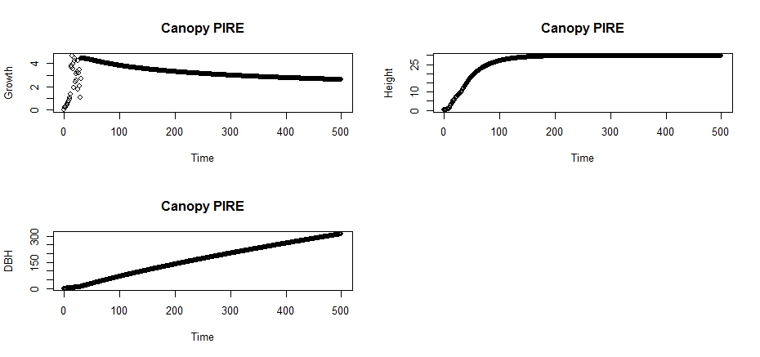
PIRE

Slide 11
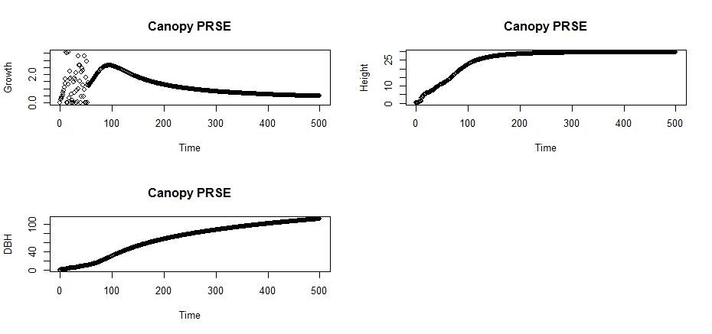
PRSE

Slide 12
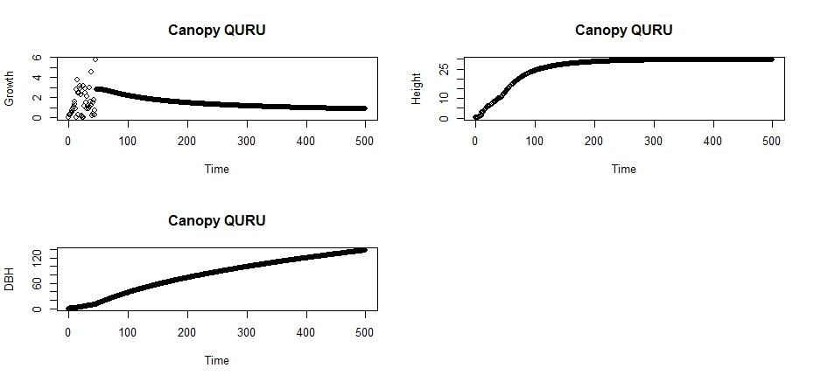
QURU

Slide 13
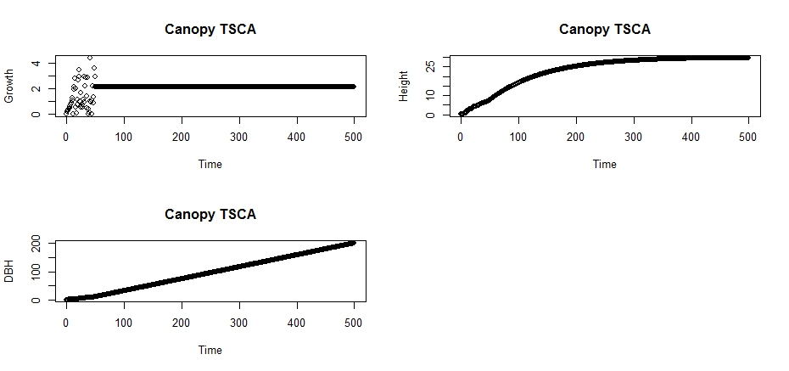
TSCA .

Slide 14
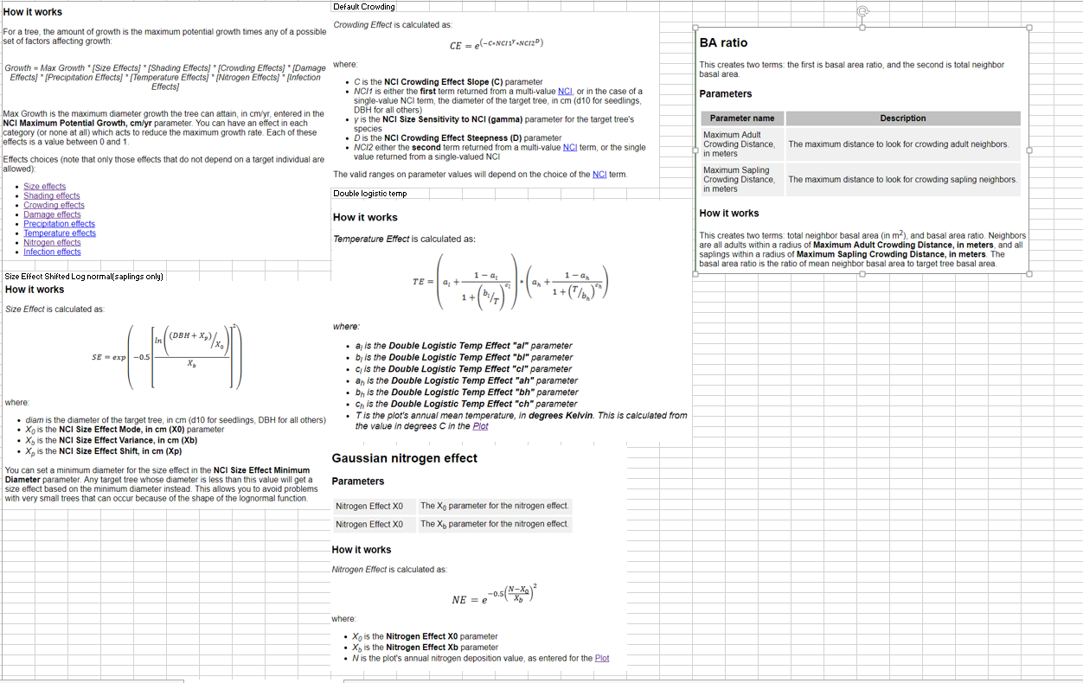
Sapling Growth FRAM

Slide 15
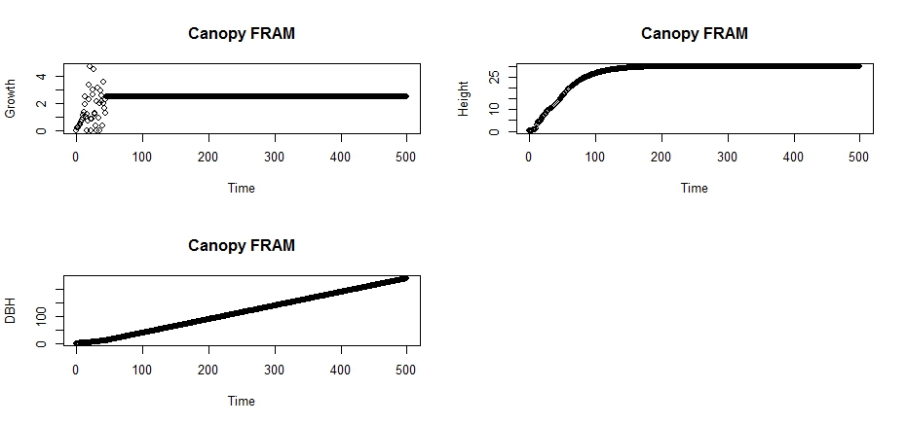
FRAM

Slide 16
Understory
NCI GROWTH GLI constant at 1%

Slide 17
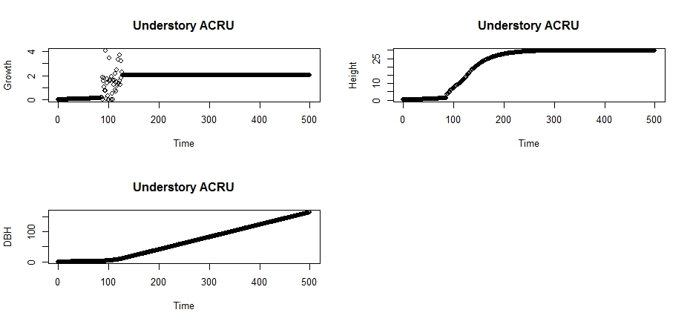
ACRU(under)

Slide 18
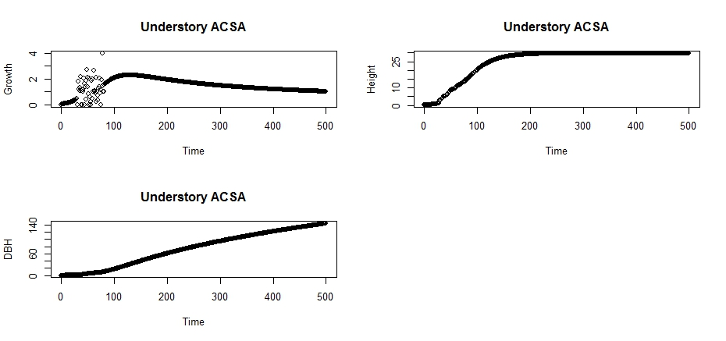
ACSA(under)

Slide 19

BEAL(under)

Slide 20
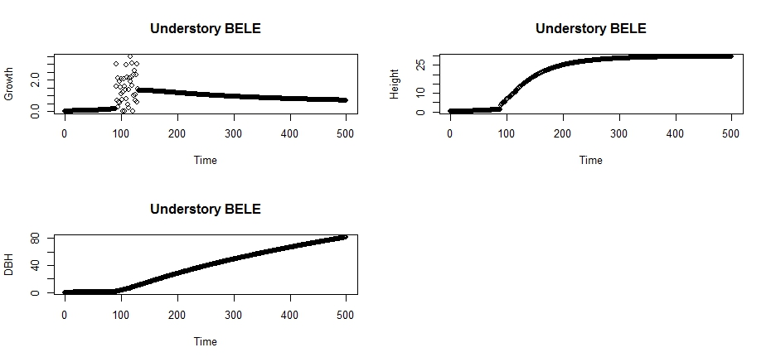
BELE(under)

Slide 21
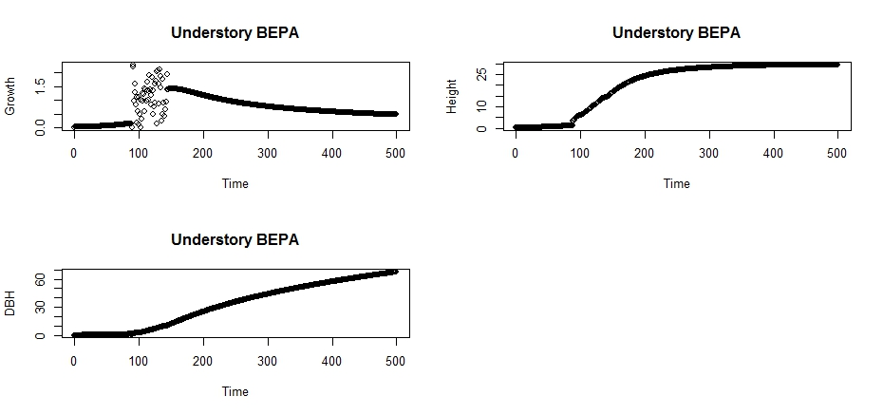
BEPA(under)

Slide 22
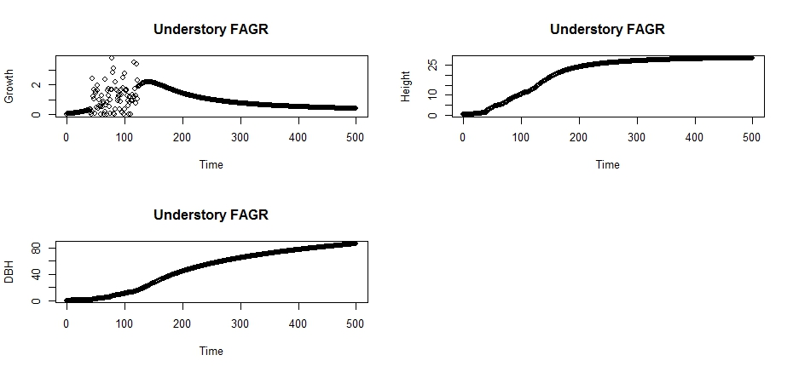
FAGR(under)

Slide 23
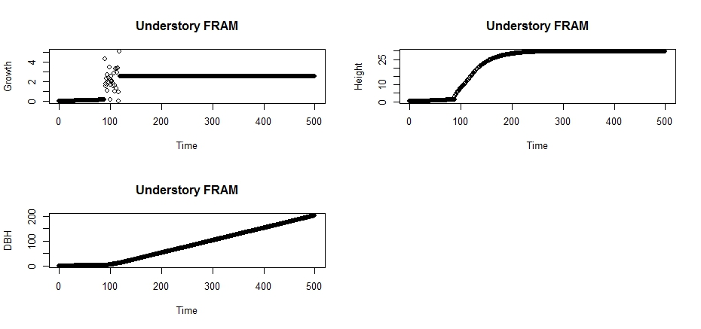
FRAM(under)

Slide 24
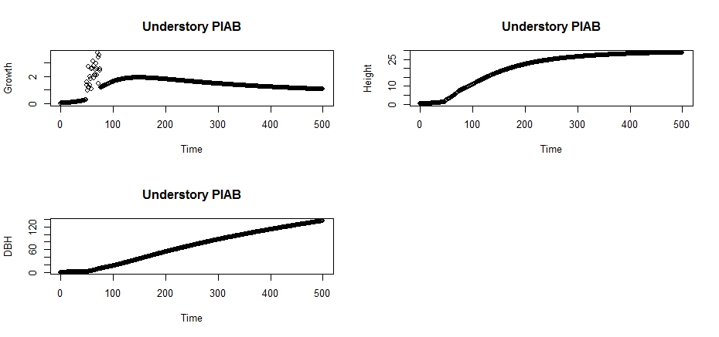
PIAB (under)

Slide 25
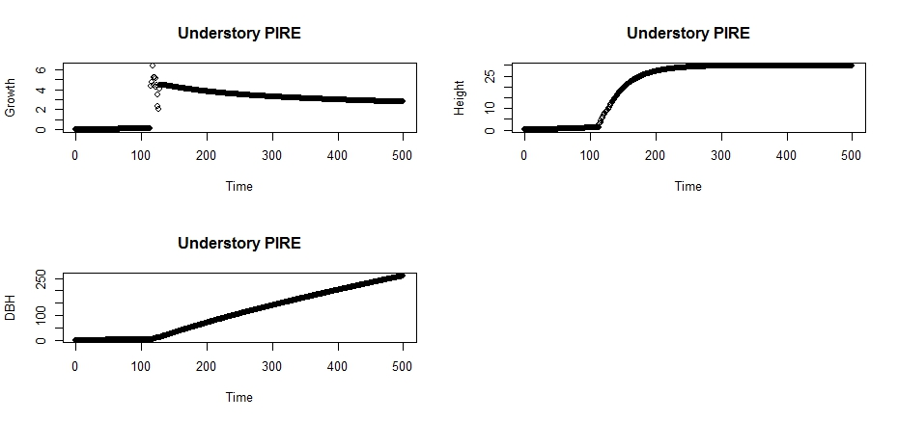
PIRE(under)

Slide 26
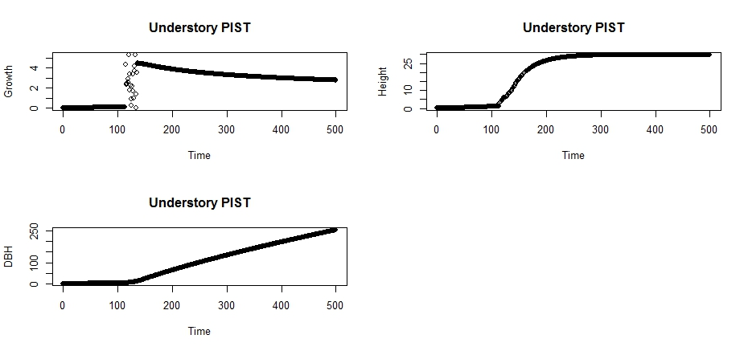
PIST(under)

Slide 27
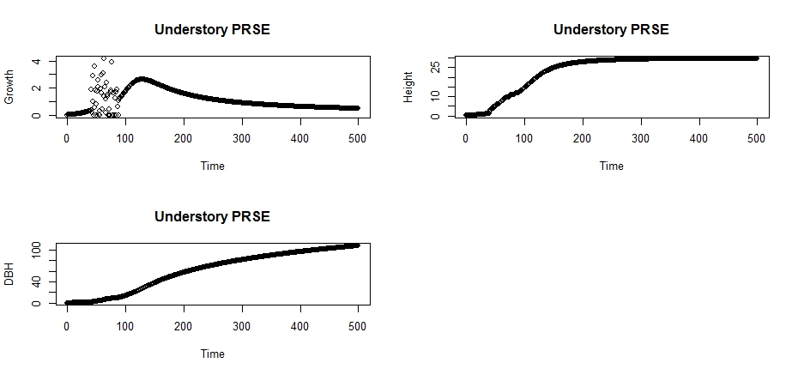
PRSE(under)

Slide 28
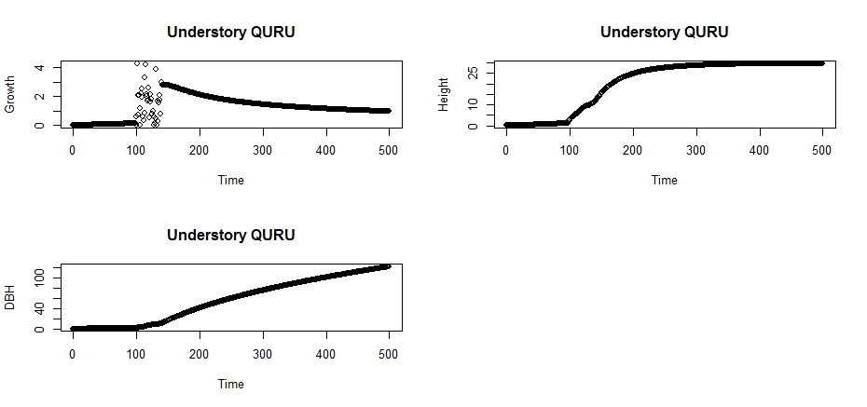
QURU(under)

Slide 29
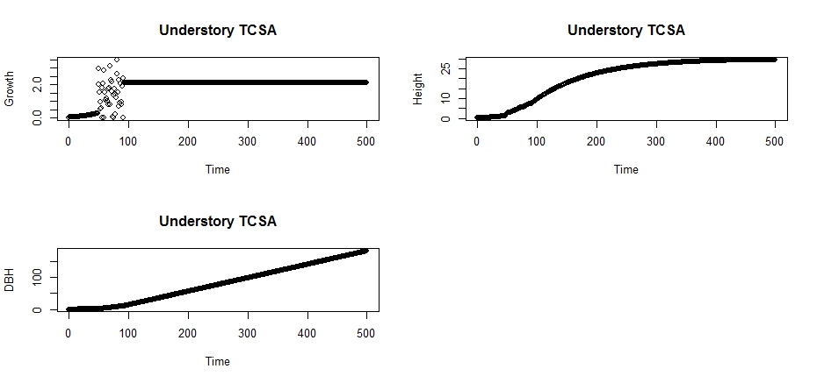
TSCA(under)

